Slide 1
EMS702UP Statistical Thinking and Applied Machine Learning
W4.1-4.3 Introduction to Fuzzy Sets and Relations
Jun Chen

Slide 2
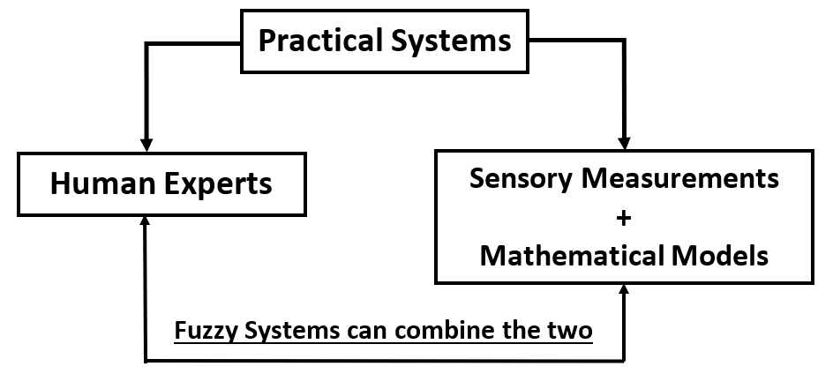

Introduction to Fuzzy Systems
There are two justifications for adopting fuzzy systems.
Real world is too complicated to model and fuzziness is introduced to obtain a reasonable model.
There is increasing dissatisfaction with quantitative approaches. Human knowledge is becoming more and more important. The fuzziness concept can formulate knowledge in a systematic manner and give it an engineering flavour.
A good engineering theory is one that makes use of all available information effectively.

Slide 3
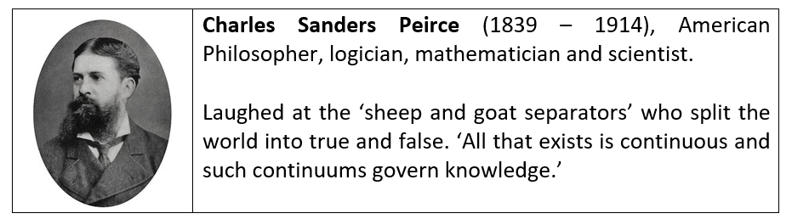
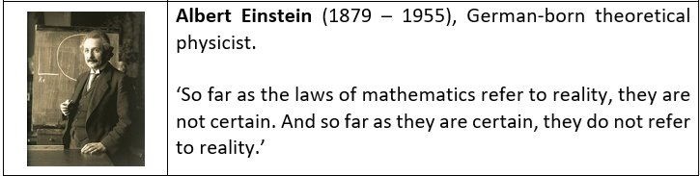
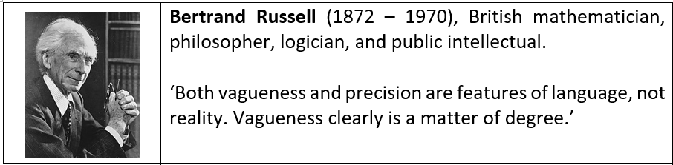
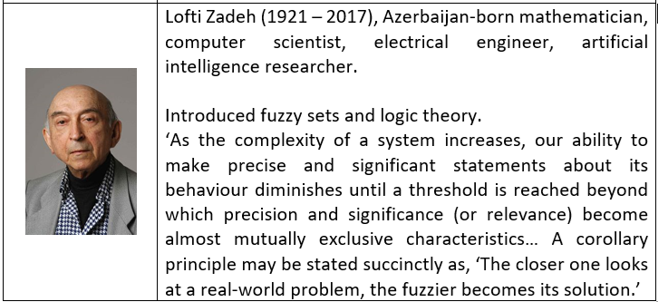
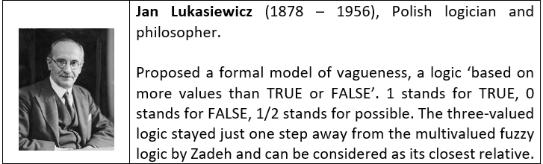
Introduction to Fuzzy Systems
Some great logicians, mathematicians, and scientists shared their views about the world and reality.
https://ieeexplore.ieee.org/stamp/stamp.jsp?tp=&arnumber=8253762

Slide 4
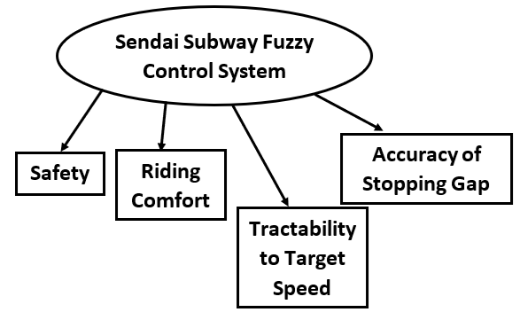
Introduction to Fuzzy Systems
Some examples of applications of fuzzy systems include
Fuzzy washing machines: the first major products to use fuzzy systems (Matsushita Electric Industrial Company in Japan in 1991). The fuzzy system, hence built, had 3 inputs (dirtiness, dirt type and load size), which were ‘measured’ using optical sensors, and one output (correct cycle).
Fuzzy control of subway train (Sendai Subway in Japan): the most significant application of fuzzy systems to date, which is still operational and is still considered to be the most advanced subway system in the world. The following is a configuration of the control systems.
The controller was represented by two levels:
Level 1: Constant speed controller – starts the train and Keeps speed below its safety limit
For Riding Comfort: IF the speed of the train is in the allowed range, THEN do not change the control notch
Level 2: Automatic stopping controller – regulates speed limit to stop at target position
For Safety: IF the speed of the train is approaching the limit speed, THEN select the maximum brake notch

Slide 5

Introduction to Fuzzy Systems
Brief history of fuzzy technology
1965 Concept of fuzzy sets theory by Lofti Zadeh (USA)
1972 First working group on fuzzy systems in Japan by Toshiro Terano
1973 Paper about fuzzy algorithms by Zadeh (USA)
1974 Steam engine control by Ebrahim Mamdani (UK)
1977 First fuzzy expert system for loan applicant evaluation by Hans Zimmermann (Gemany)
1980 Cement Kiln control by F. L. Smidth & Co. – Lauritz P Holmblad (Denmark) – the first permanent industrial application
Fuzzy logic chess and backgammon program – Hans Berliner (USA)
1984 Water treatment (chemical injection) control (Japan)
Subway Sendai transportation system control (Japan)
1985 First fuzzy chip developed by Masaki Togai and Hiroyuke Watanabe in Bell Labs (USA)
https://brain.edusoft.ro/index.php/brain/article/viewFile/308/390

Slide 6

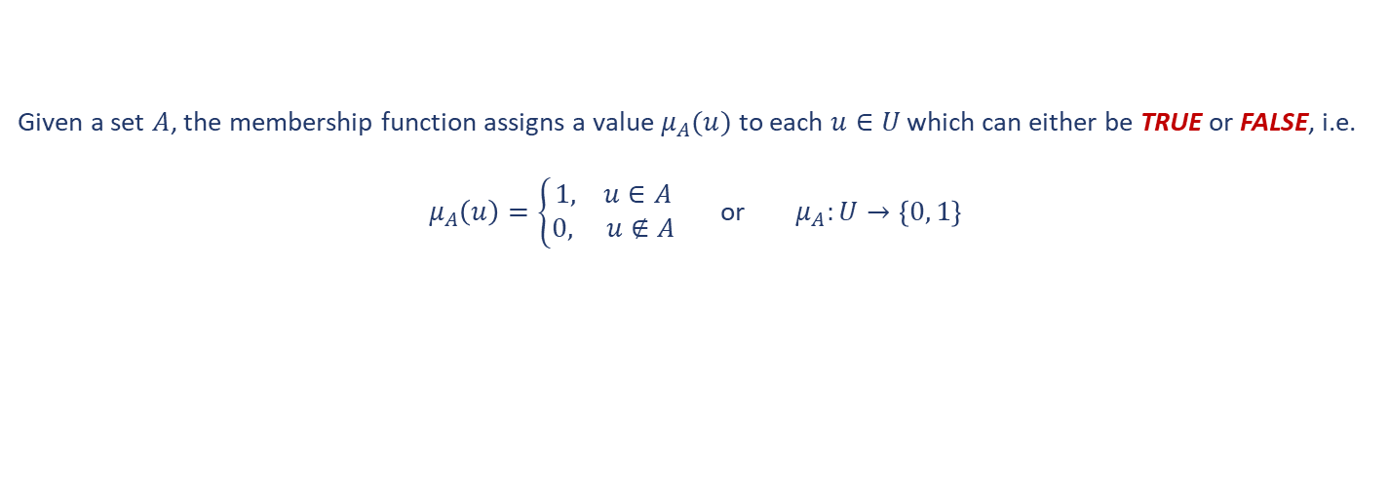
Introduction to Fuzzy Systems – Fuzzy Sets Definitions
Traditionally, a set is defined as a collection of objects of any kind, numbers, geometric points, chairs, pencils, etc. Usually, naming all members of the set will determine the set.
An individual object $u$ is a member of a set $A:$ $u∈A$
$u$ is not a member of a set $A:$ $u∉A$
Any set is said to be a subset of a Universal Set that contains all possible elements having the nature as well as the property which are under considerations.
The processes by which individuals from the universal set $U$ are determined to be either members or non-members of a set, is known as mapping the universal set into the determined set. As a mapping, it can be defined by a function which is referred to as the characteristic function (or Membership Function).
Given a set $A$, the membership function assigns a value $μ_{A}(u)$ to each $u∈U$ which can either be TRUE or FALSE, i.e.
$μ_{A}\left(u\right)=\left\{\begin{aligned}1, u∈A \\ 0, u∉A\end{aligned}\right.$ or $μ_{A}:U→\left\{0, 1\right\}$

Slide 7
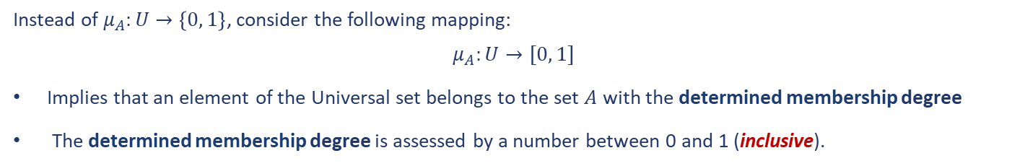
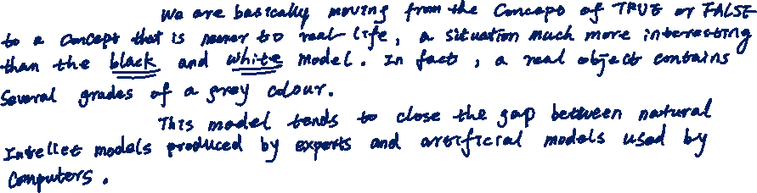
Introduction to Fuzzy Systems – Fuzzy Sets Definitions
Instead of $μ_{A}:U→\left\{0, 1\right\}$, consider the following mapping:
$$μ_{A}:U→[0, 1]$$
Implies that an element of the Universal set belongs to the set $A$ with the determined membership degree
The determined membership degree is assessed by a number between 0 and 1 (inclusive).
Summary of fuzzy sets:

Slide 8



Introduction to Fuzzy Systems – Fuzzy Sets Definitions
A fuzzy set in the universal set $U$ is a set of ordered pairs of an element $u$ and its membership degree $μ_{A}(u)$ such as
$$A=\left\{\left(u , , μ_{A}\left(u\right)u∈U\right\}\right.$$
Notes:
A fuzzy set is given by its membership function $μ_{A}(u)$. The value of this function determines if the element belongs to the fuzzy set and to what extent (degree).
We should not confuse the term ‘certainty’ with probability or likelihood. $μ_{A}(u)$ is not a probability density function, i.e. $certainty≡Degree of Truth$.
Example 1
Indicate the membership degrees of each box belonging to high boxes.
Solution

Slide 9
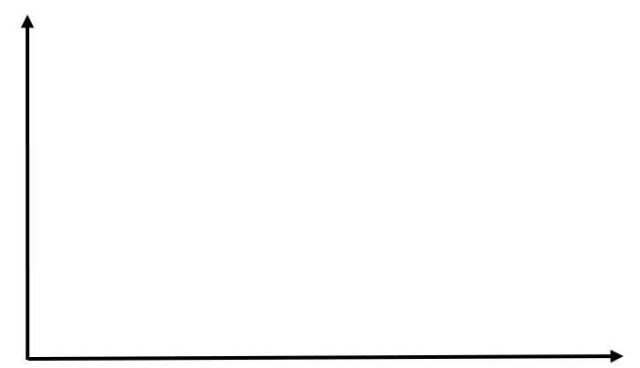

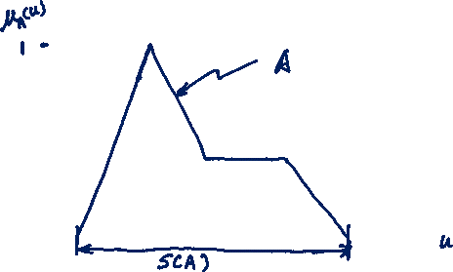
Introduction to Fuzzy Systems – Fuzzy Sets Definitions
The support $S(A)$ of a fuzzy set $A$ is the crisp set of all the elements of the Universal Set for which the membership function value is non-zero, i.e.
$$S\left(A\right)=\left\{ μ_{A}\left(u\right)>0 | u∈U\right\}$$

Slide 10
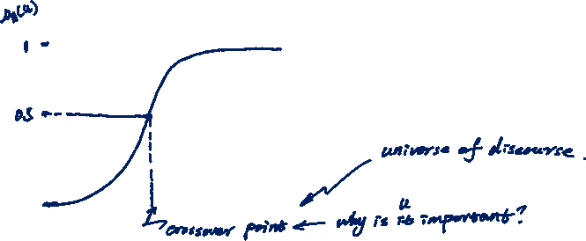
Introduction to Fuzzy Systems – Fuzzy Sets Definitions
The crossover point corresponds to the element of the Universal Set for which the membership function has the value of 0.5.
Note: the crossover point marks the point where the certainty of belonging becomes lower than the certainty of not belonging.

Slide 11
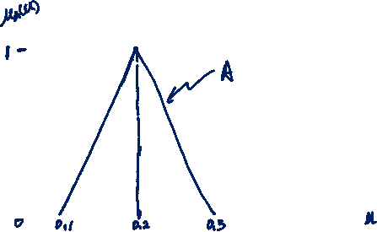

Introduction to Fuzzy Systems – Fuzzy Sets Definitions
There are different shapes of membership functions which can be used in a particular fuzzy system.
(1) Triangular
In the continuous case, we have
$$μ_{A}\left(u\right)=\left\{\begin{aligned}0 \\ \\ \frac{u−a_{1}}{a_{2}−a_{1}} \\ \\ \frac{a_{3}−u}{a_{3}−a_{2}} \\ \\ 0\end{aligned}\right. \begin{aligned}u<a_{1} \\ \\ a_{1}≤u≤a_{2} \\ \\ \\ a_{2}≤u≤a_{3} \\ \\ \\ u≥a_{3}\end{aligned}$$

Slide 12
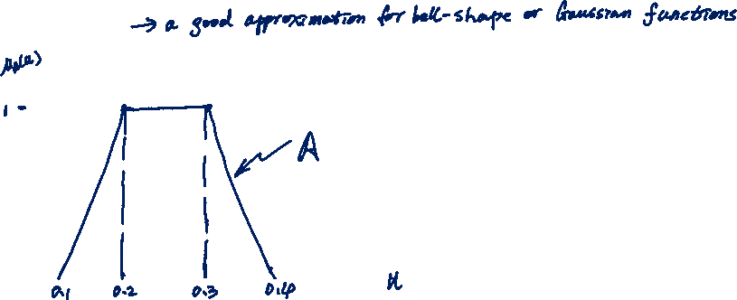

Introduction to Fuzzy Systems – Fuzzy Sets Definitions
There are different shapes of membership functions which can be used in a particular fuzzy system.
(2) Trapezoidal
In the continuous case, we have
$$μ_{A}\left(u\right)=\left\{\begin{aligned}0 \\ \\ \frac{u−a_{1}}{a_{2}−a_{1}} \\ \\ 1 \\ \\ \frac{a_{4}−u}{a_{4}−a_{3}} \\ \\ 0\end{aligned}\right. \begin{aligned}u<a_{1} \\ \\ \\ a_{1}≤u<a_{2} \\ \\ a_{2}≤u<a_{3} \\ \\ a_{3}≤u<a_{4} \\ \\ \\ u≥a_{4}\end{aligned}$$

Slide 13
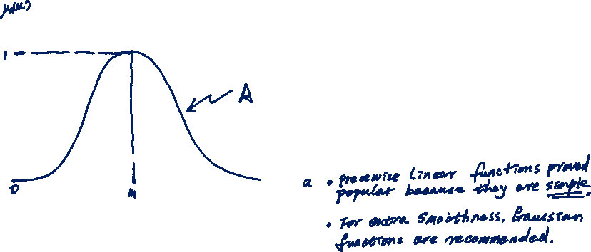

Introduction to Fuzzy Systems – Fuzzy Sets Definitions
There are different shapes of membership functions which can be used in a particular fuzzy system.
(3) Gaussian
$$μ_{A}\left(u\right)=e^{−{\left(\frac{u−m}{σ}\right)}^{2}}$$
Question
Which membership function shape will at best represent fuzzy systems?
Answer

Slide 14
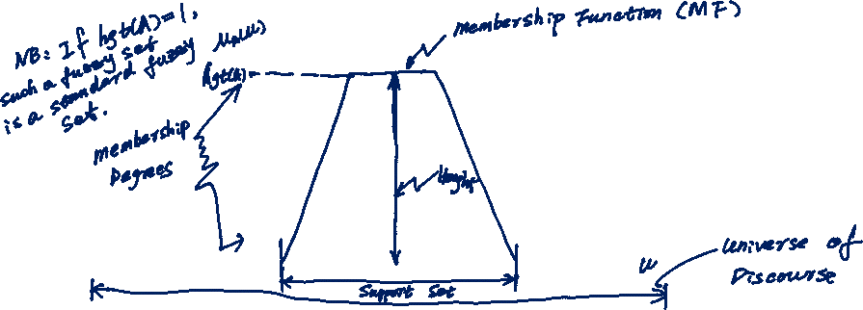
Introduction to Fuzzy Systems – Fuzzy Sets Definitions
The height of a fuzzy set $A$, $hgt(A)$, is given by the maximum of the membership function over all $u∈U$.
As a summary, we have:

Slide 15
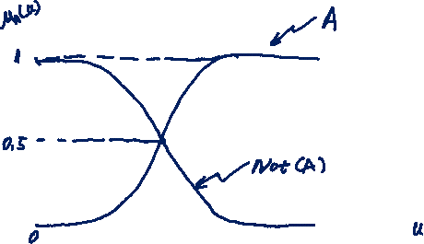
Introduction to Fuzzy Systems – Fuzzy Sets Operations
The complement of a fuzzy set $A$ has a membership function which is defined for all $u∈U$ by
$$\overline{μ_{A}}\left(u\right)=1−μ_{A}\left(u\right)$$

Slide 16

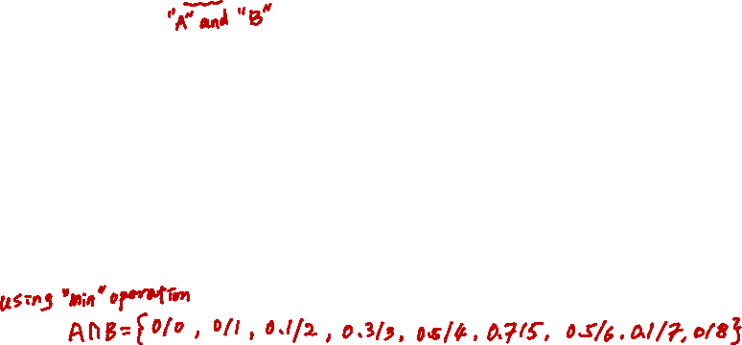
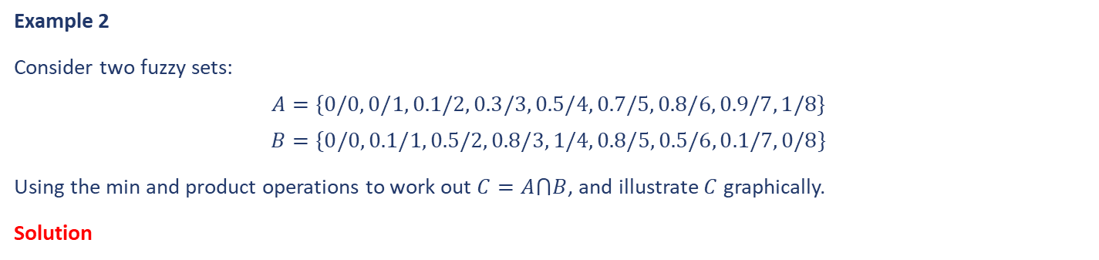
Introduction to Fuzzy Systems – Fuzzy Sets Operations
The intersection of two fuzzy sets $C=A⋂B$ is a fuzzy set with the following membership function:
Note: the product operation introduces more smoothness in the data output than the min operation.
Example 2
Consider two fuzzy sets:
$$A=\{0/0, 0/1, 0.1/2, 0.3/3, 0.5/4, 0.7/5, 0.8/6, 0.9/7, 1/8\}$$
$$B=\{0/0, 0.1/1, 0.5/2, 0.8/3, 1/4, 0.8/5, 0.5/6, 0.1/7, 0/8\}$$
Using the min and product operations to work out $C=A⋂B$, and illustrate $C$ graphically.
Solution

Slide 17
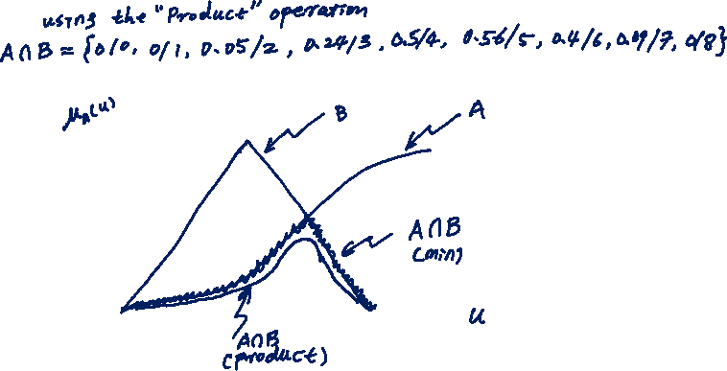
Introduction to Fuzzy Systems – Fuzzy Sets Operations
Example 2 Continued…
Solution

Slide 18

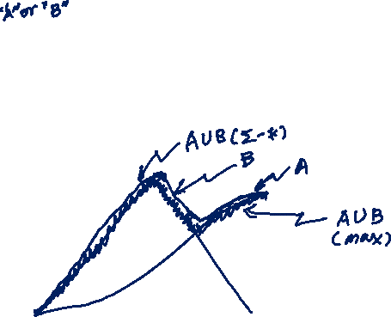

Introduction to Fuzzy Systems – Fuzzy Sets Operations
The union of two fuzzy sets $C=A∪B$ is a fuzzy set with the following membership function:
$$μ_{C=A∪B}\left(u\right)=\left\{\begin{aligned}max⁡(μ_{A}\left(u\right), μ_{B}\left(u\right)) \\ μ_{A}\left(u\right)+μ_{B}\left(u\right)−μ_{A}\left(u\right)∙μ_{B}\left(u\right)\end{aligned}\right.$$
Example 3
Consider the same two fuzzy sets in Example 2, illustrate $C=A∪B$ graphically.
Solution

Slide 19


Introduction to Fuzzy Systems – Extension Principles
The extension principles (one of the most important result of fuzzy sets theory) enable us to get a fuzzy model for a variable if we know the fuzzy model for another variable and the functional relationship between them. The extension principles allow one to calculate the output of a fuzzy system.
Extension Principal 1: if ‘$A$’ is a fuzzy set in the universe ‘$U$’ and ‘$f$’ is a mapping from ‘$U$’ to the universe of discourse ‘$Y$’ such that $y=f(u)$, then the extension principal allows to define a fuzzy set ‘$B$’ in ‘$Y$’ such that
$$B=f\left(A\right)=\left\{\left(y,μ_{B}\left(y\right) \right) | y=f\left(u\right), u∈U\right\}$$
Where,
$$μ_{B}\left(y\right)=\left\{\begin{aligned}supμ_{A}\left(u\right) \\ 0\end{aligned} \right.\begin{aligned}if f^{−1}(y)≠0 \\ if f^{−1}\left(y\right)=0\end{aligned}$$
Why “Supremum” operation?

Slide 20
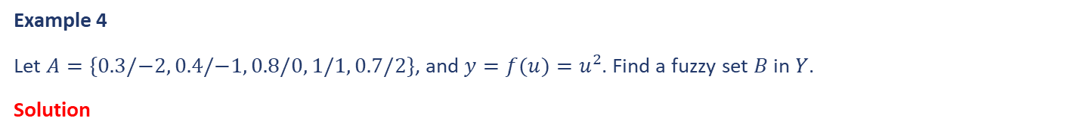
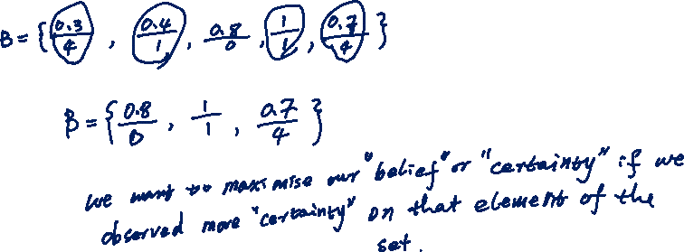
Introduction to Fuzzy Systems – Extension Principles
Example 4
Let $A=\{0.3/−2, 0.4/−1, 0.8/0, 1/1, 0.7/2\}$, and $y=f(u)=u^{2}$. Find a fuzzy set $B$ in $Y$.
Solution
Extension principal 1 deals with 1 input. When we have more than one input, we will need Extension Principal 2.

Slide 21

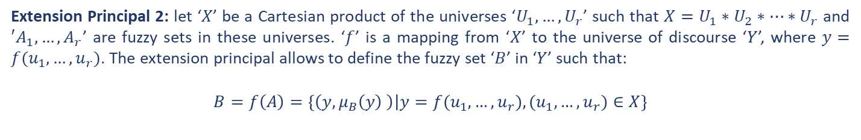
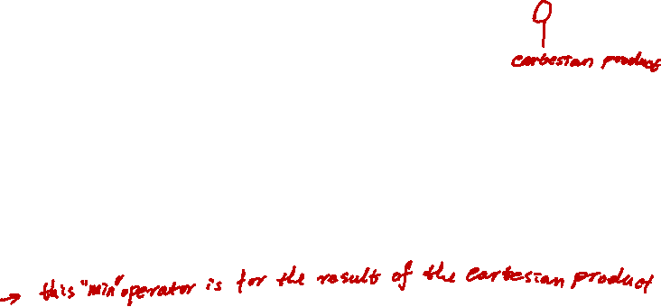
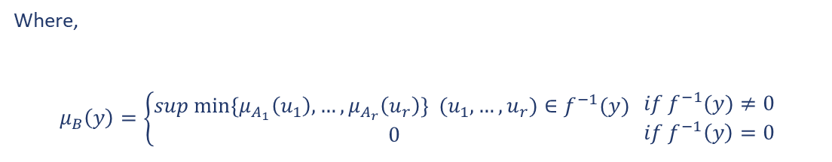
Introduction to Fuzzy Systems – Extension Principles
Extension Principal 2: let ‘$X$’ be a Cartesian product of the universes ‘$U_{1},…,U_{r}$’ such that $X=U_{1}∗U_{2}∗…∗U_{r}$ and $′A_{1},…,A_{r}$’ are fuzzy sets in these universes. ‘$f$’ is a mapping from ‘$X$’ to the universe of discourse ‘$Y$’, where $y=f(u_{1},…,u_{r})$. The extension principal allows to define the fuzzy set ‘$B$’ in ‘$Y$’ such that:
$$B=f\left(A\right)=\left\{\left(y,μ_{B}\left(y\right) \right) | y=f(u_{1},…,u_{r}), (u_{1},…,u_{r})∈X\right\}$$
Where,
$$μ_{B}\left(y\right)=\left\{\begin{aligned}sup{ min⁡\{μ}_{A_{1}}\left(u_{1}\right),…,μ_{A_{r}}\left(u_{r}\right)\} {(u}_{1},…,u_{r})∈f^{−1}(y) \\ 0\end{aligned} \right.\begin{aligned}if f^{−1}(y)≠0 \\ if f^{−1}\left(y\right)=0\end{aligned}$$
Why “Min” operation?

Slide 22
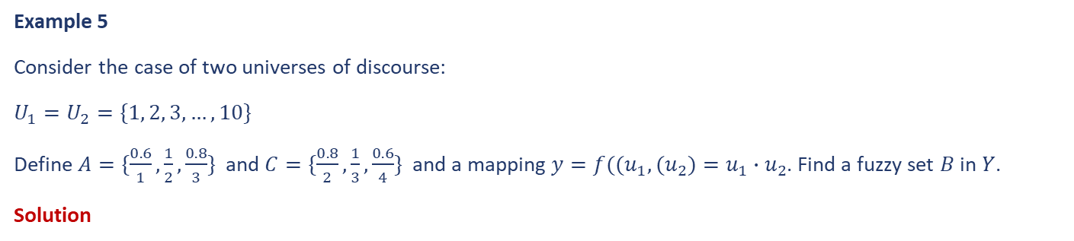
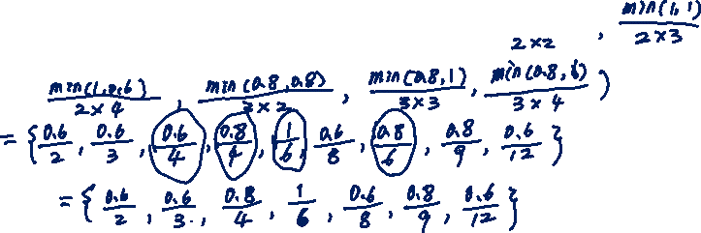
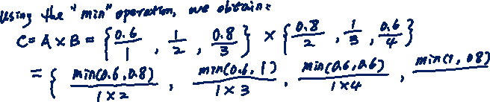
Introduction to Fuzzy Systems – Extension Principles
Example 5
Consider the case of two universes of discourse:
$U_{1}=U_{2}=\{1, 2, 3,…, 10\}$
Define $A=\{\frac{0.6}{1},\frac{1}{2},\frac{0.8}{3}\}$ and $C=\{\frac{0.8}{2},\frac{1}{3},\frac{0.6}{4}\}$ and a mapping $y=f({(u}_{1},{(u}_{2})=u_{1}∙u_{2}$. Find a fuzzy set $B$ in $Y$.
Solution

Slide 23
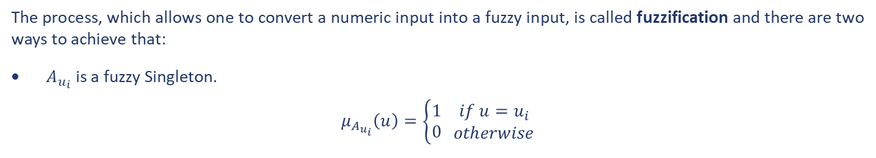
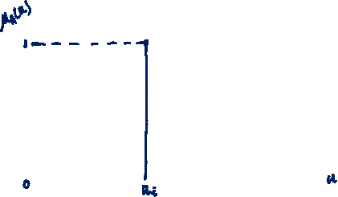
Introduction to Fuzzy Systems – Fuzzification
The process, which allows one to convert a numeric input into a fuzzy input, is called fuzzification and there are two ways to achieve that:
$A_{u_{i}}$ is a fuzzy Singleton.
$$μ_{A_{u_{i}}}\left(u\right)=\left\{\begin{aligned}1 \\ 0\end{aligned} \begin{aligned}if u=u_{i} \\ otherwise\end{aligned}\right.$$
Note: Singleton fuzzification is generally used in implementations where there is no noise

Slide 24
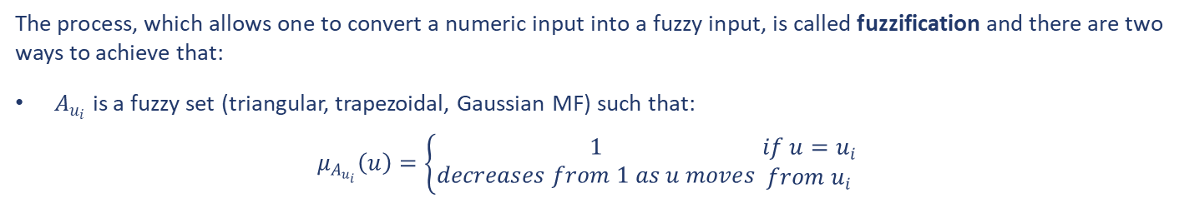
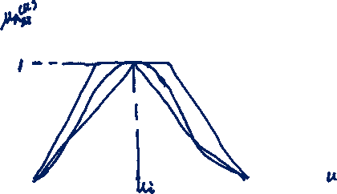
Introduction to Fuzzy Systems – Fuzzification
The process, which allows one to convert a numeric input into a fuzzy input, is called fuzzification and there are two ways to achieve that:
$A_{u_{i}}$ is a fuzzy set (triangular, trapezoidal, Gaussian MF) such that:
$$μ_{A_{u_{i}}}\left(u\right)=\left\{\begin{aligned}1 \\ decreases from 1 as u moves\end{aligned} \begin{aligned}if u=u_{i} \\ from u_{i}\end{aligned}\right.$$

Slide 25

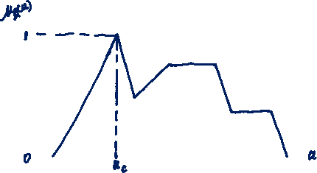
Introduction to Fuzzy Systems – Defuzzification
The conversion of a fuzzy quantity into a crisp one is done via a defuzzification operation. Several defuzzification methods do exist and here we will review the most popular three.
$\text{Max}\text{−}\text{Membership} \text{method}$
$u_{c}$ is chosen such that
$$∀u∈U, μ_{A}\left(u_{c}\right)≥μ_{A}\left(u\right)$$

Slide 26
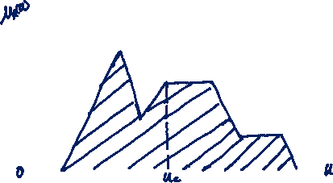

Introduction to Fuzzy Systems – Defuzzification
$\text{Centroid} \text{of} \text{Gravity}\text{ (}\text{Area}\text{) (}\text{COG}\text{) }\text{method}$
Any disadvantage?
$u_{c}$ is chosen such that it represents the centre of the above shaded area, i.e.
$$μ_{c}=\left\{\begin{aligned}\frac{\int{μ_{A}(u)∙u∙du}}{\int{μ_{A}(u)∙du}} \\ \frac{\sum{μ_{A}(u)∙u}}{\sum{μ_{A}(u)}}\end{aligned} \begin{aligned}in the continuous case \\ \\ in the discrete case\end{aligned}\right.$$

Slide 27
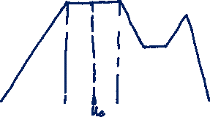
Introduction to Fuzzy Systems – Defuzzification
$\text{M}\text{ean}\text{-}\text{of}\text{-}\text{Maxima}\text{ (}\text{MOM}\text{) }\text{method}$
This method consists of taking the mean level of all maxima within the fuzzy membership shape.

Slide 28
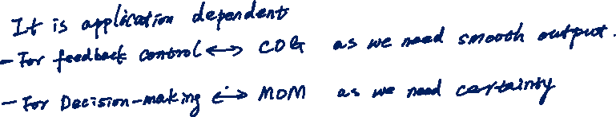
Introduction to Fuzzy Systems – Defuzzification
Example 6
Which method proved better as far as designing fuzzy systems is concerned?
Solution

Slide 29
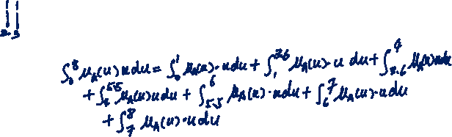
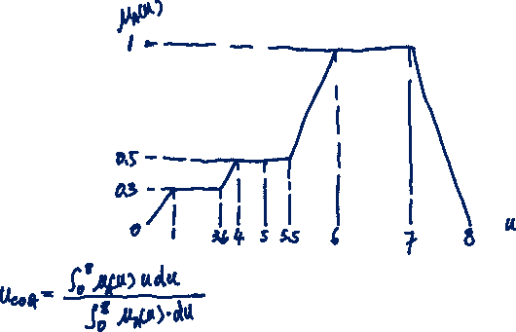
Introduction to Fuzzy Systems – Defuzzification
Example 7
Consider the following fuzzy set:
Find the defuzzified crisp values using the COG and MOM methods.
Solution

Slide 30
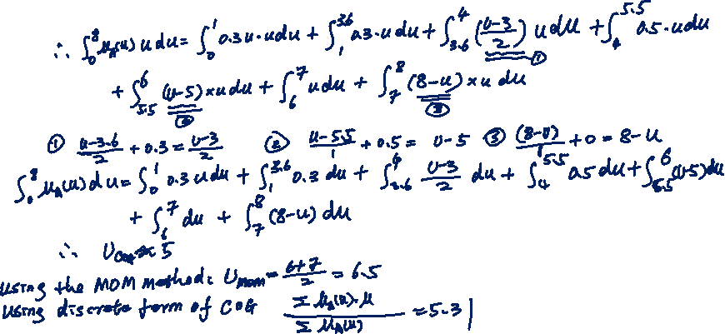
Introduction to Fuzzy Systems – Defuzzification
Example 7 Continued…
Solution

Slide 31
Introduction to Fuzzy Systems – Fuzzy Relations
Having described operations between fuzzy sets, we need to look at how we can represent linguistic statements mathematically. In fact, many application problem descriptions include fuzzy relations. A fuzzy system is usually represented by statements or rules of the following form:
$$IF speed is slow then pressure should be high$$
A
B
$$IF A then B or A→B$$
A fuzzy relation of the form $A→B$ is denoted $R$.

Slide 32
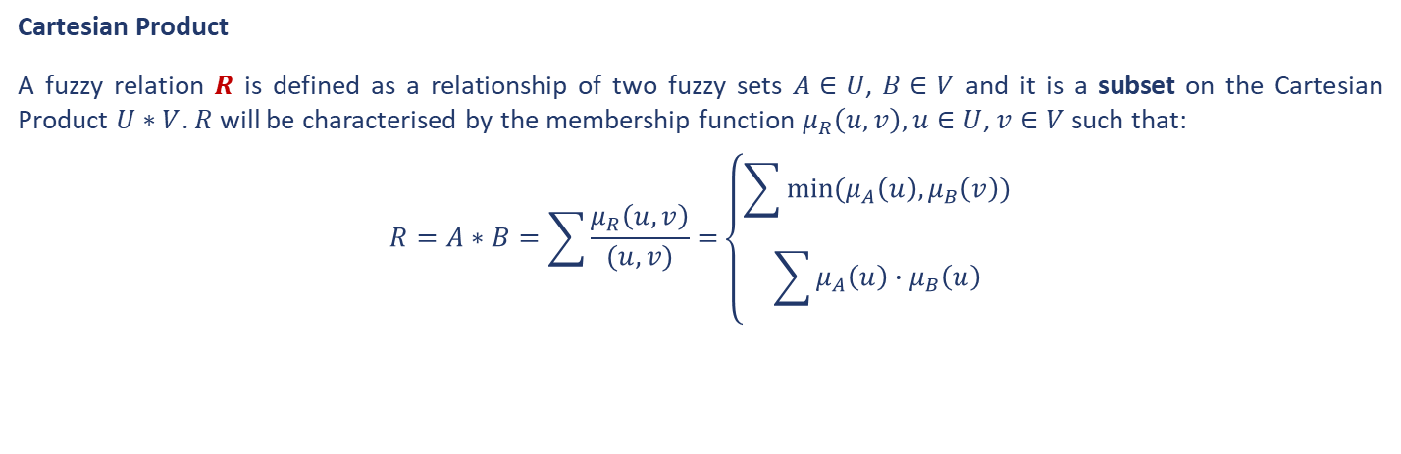
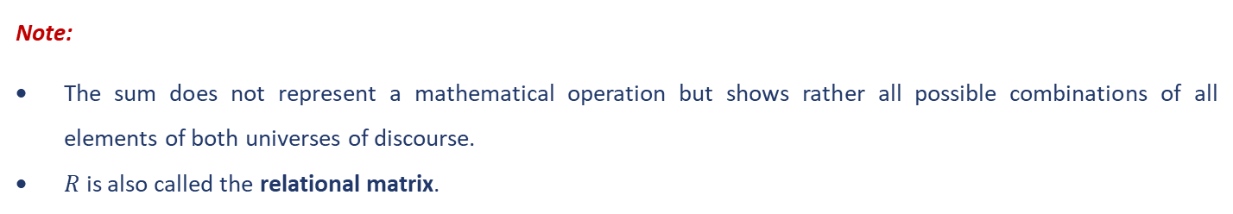
Introduction to Fuzzy Systems – Fuzzy Relations
Cartesian Product
A fuzzy relation $R$ is defined as a relationship of two fuzzy sets $A∈U$, $B∈V$ and it is a subset on the Cartesian Product $U∗V$. $R$ will be characterised by the membership function $μ_{R}\left(u, v\right), u∈U$, $v∈V$ such that:
$$R=A∗B=\sum{\frac{μ_{R}\left(u, v\right)}{(u,v)}=}\left\{\begin{aligned}\sum{min⁡(μ_{A}\left(u\right),μ_{B}\left(v\right))} \\ \sum{μ_{A}\left(u\right)∙μ_{B}\left(u\right)}\end{aligned}\right.$$
Note:
The sum does not represent a mathematical operation but shows rather all possible combinations of all elements of both universes of discourse.
$R$ is also called the relational matrix.

Slide 33
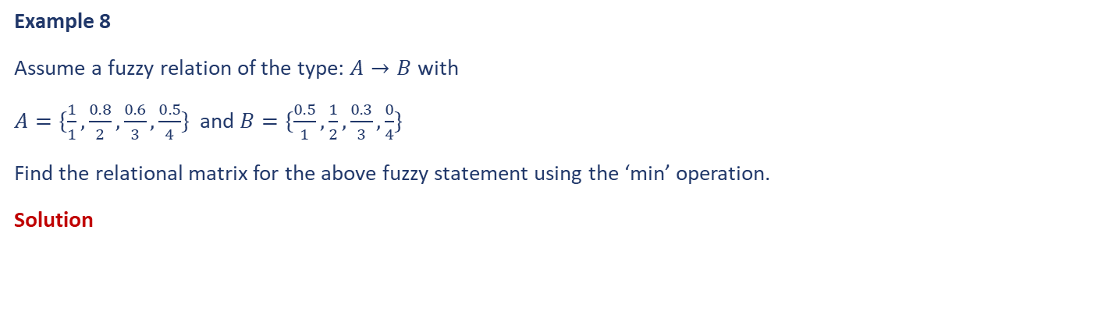
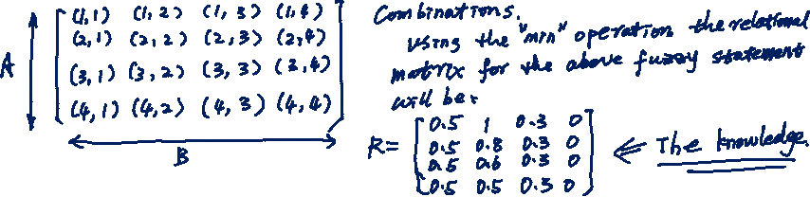
Introduction to Fuzzy Systems – Fuzzy Relations
Example 8
Assume a fuzzy relation of the type: $A→B$ with
$A=\{\frac{1}{1},\frac{0.8}{2},\frac{0.6}{3},\frac{0.5}{4}\}$ and $B=\{\frac{0.5}{1},\frac{1}{2},\frac{0.3}{3},\frac{0}{4}\}$
Find the relational matrix for the above fuzzy statement using the ‘min’ operation.
Solution

Slide 34
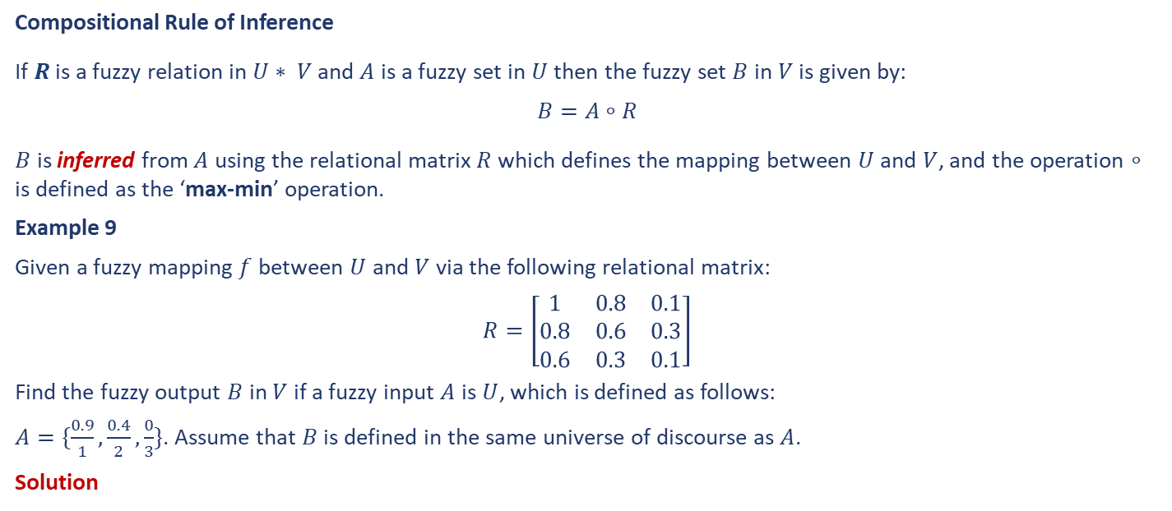
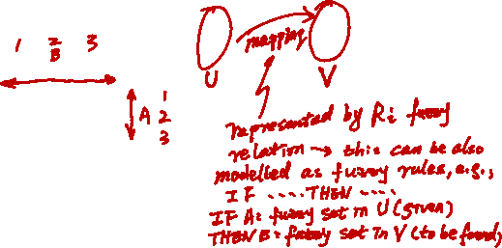
Introduction to Fuzzy Systems – Fuzzy Relations
Compositional Rule of Inference
If $R$ is a fuzzy relation in $U∗ V$ and $A$ is a fuzzy set in $U$ then the fuzzy set $B$ in $V$ is given by:
$$B=A∘R$$
$B$ is inferred from $A$ using the relational matrix $R$ which defines the mapping between $U$ and $V$, and the operation $∘$ is defined as the ‘max-min’ operation.
Example 9
Given a fuzzy mapping $f$ between $U$ and $V$ via the following relational matrix:
$$R=\left[\begin{matrix}1 & 0.8 & 0.1 \\ 0.8 & 0.6 & 0.3 \\ 0.6 & 0.3 & 0.1\end{matrix}\right]$$
Find the fuzzy output $B$ in $V$ if a fuzzy input $A$ is $U$, which is defined as follows:
$A=\{\frac{0.9}{1},\frac{0.4}{2},\frac{0}{3}\}$. Assume that $B$ is defined in the same universe of discourse as $A$.
Solution

Slide 35


Introduction to Fuzzy Systems – Fuzzy Relations
Example 9 Continued…
Solution

Slide 36
End slide

